Slide 1


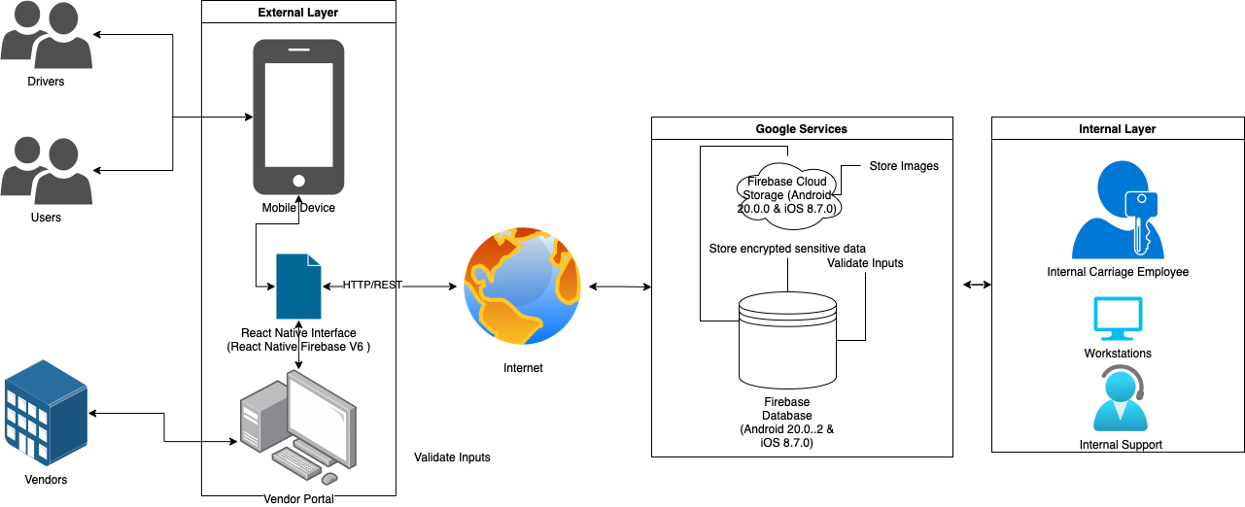
Carriage Application Architecture Type: Application Architecture View: Physical View Style: Layered Architecture Pattern

Slide 2

Application: Carriage Type: Application Architecture View: Logical View Style: Layered Architecture Pattern
Users
Deliver Channels
Core Business Processes
Data And Information
Technology Enablers
Carriage App
End-User Account
User’s Personal
Cloud Computing
Customers
Order Data
Shopping Cart
Mobile Technologies
Vendor Web Portal
Inventory Data
Vendors
E-Payment
Digital Banners & Coupons
Promotion Data
Carriage Driver App
Transactions
OAuth2
Drivers
Customize Deliveries
Payment Information
Open Source
Help Desk Web Portal
Maps
User Support Team
Vendor Geolocations
API’S
Help Desk
Help Desk Tickets

Slide 3
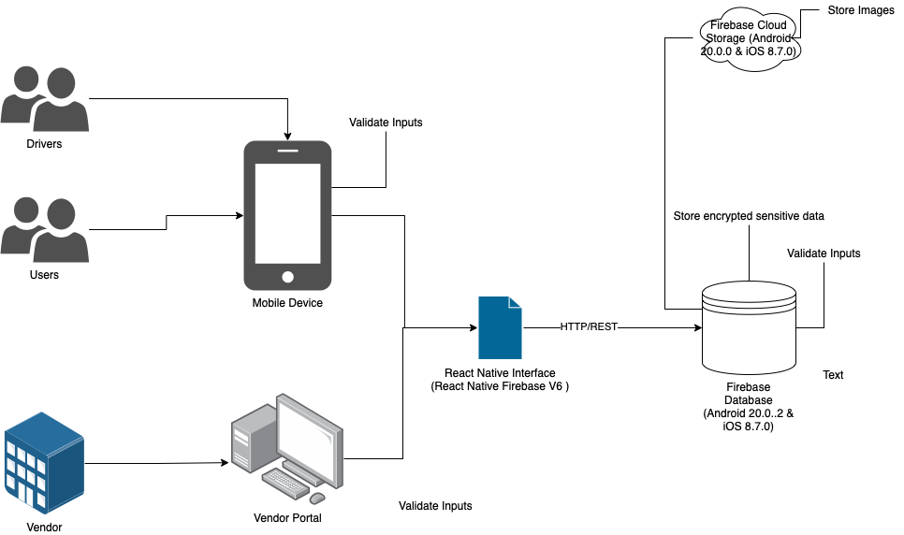
Carriage Application Architecture Type: Application Architecture View: Process View Style: Client-Server N-Tier Architecture Pattern

Slide 4
Revision Notes
09/18/2021:
Migrated from Node JS + MongoDB to using Firebase and Google Cloud Services
Added Physical Architecture Diagram
09/22/2021:
Added Versions to Google Services Products
Added React Native Firebase interface to Process and Physical Views

